Slide 1
BCCA figures
March 13 2025

Slide 3
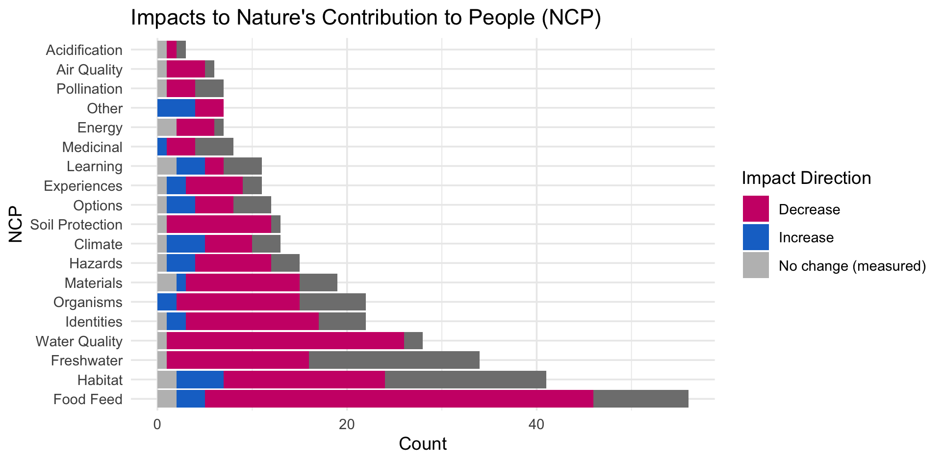

Slide 4
OLDER:

Slide 6
At least 5 entries – top – to get stats on % of entries or papers on these:

Slide 7
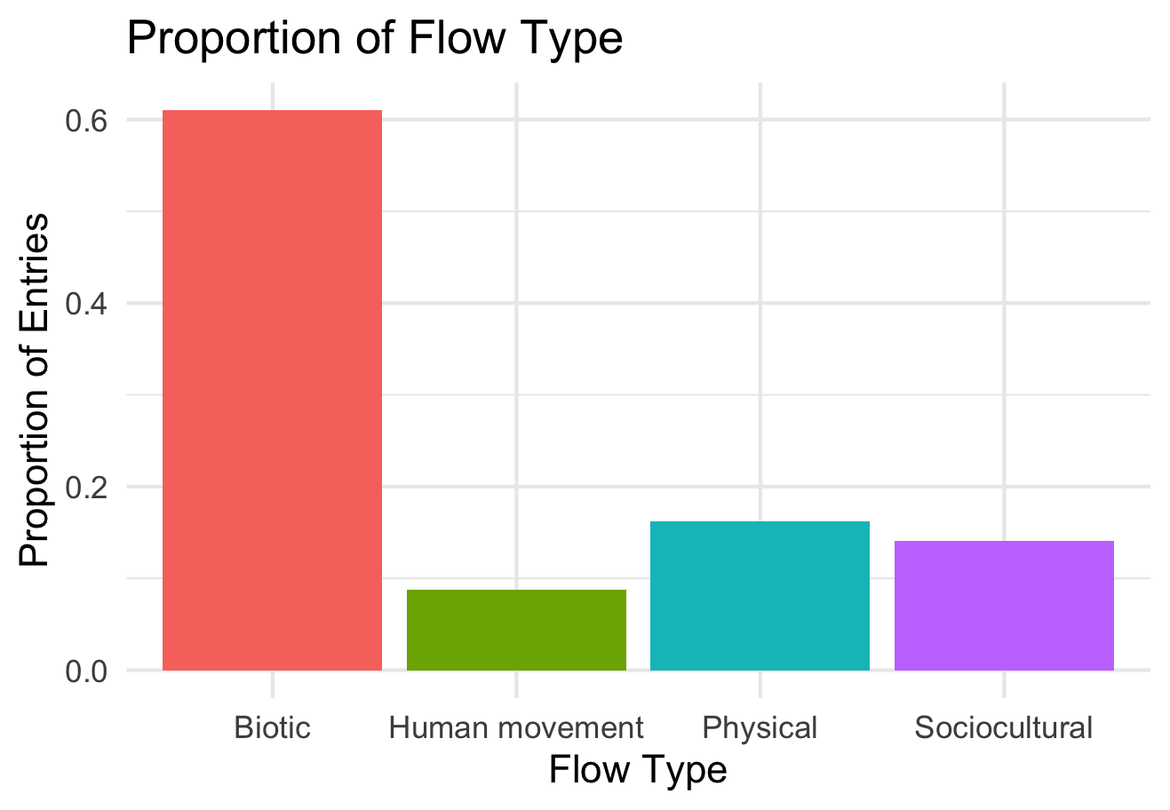

Slide 8
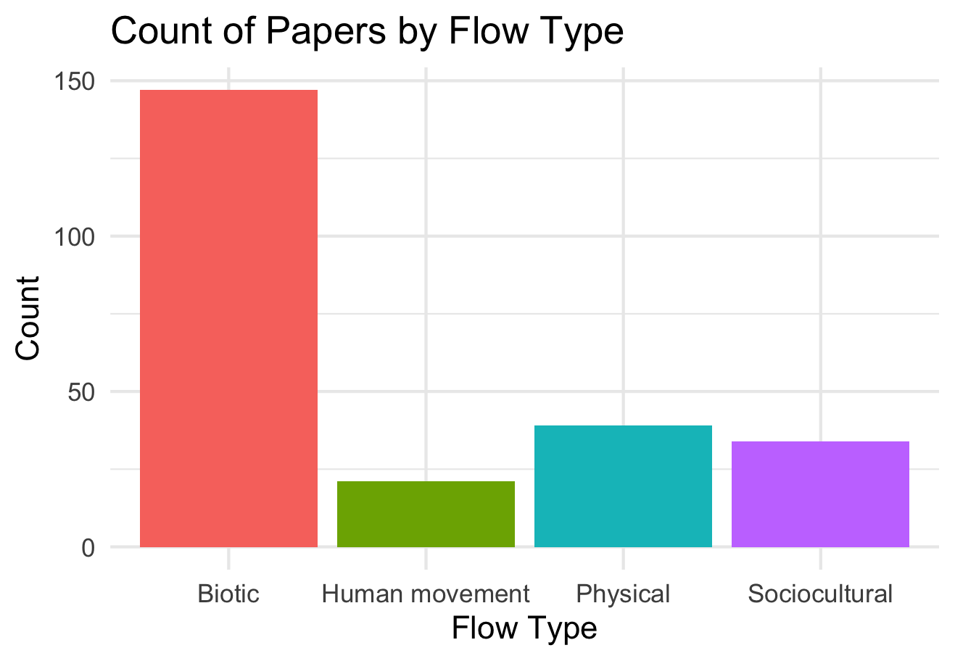

Slide 9
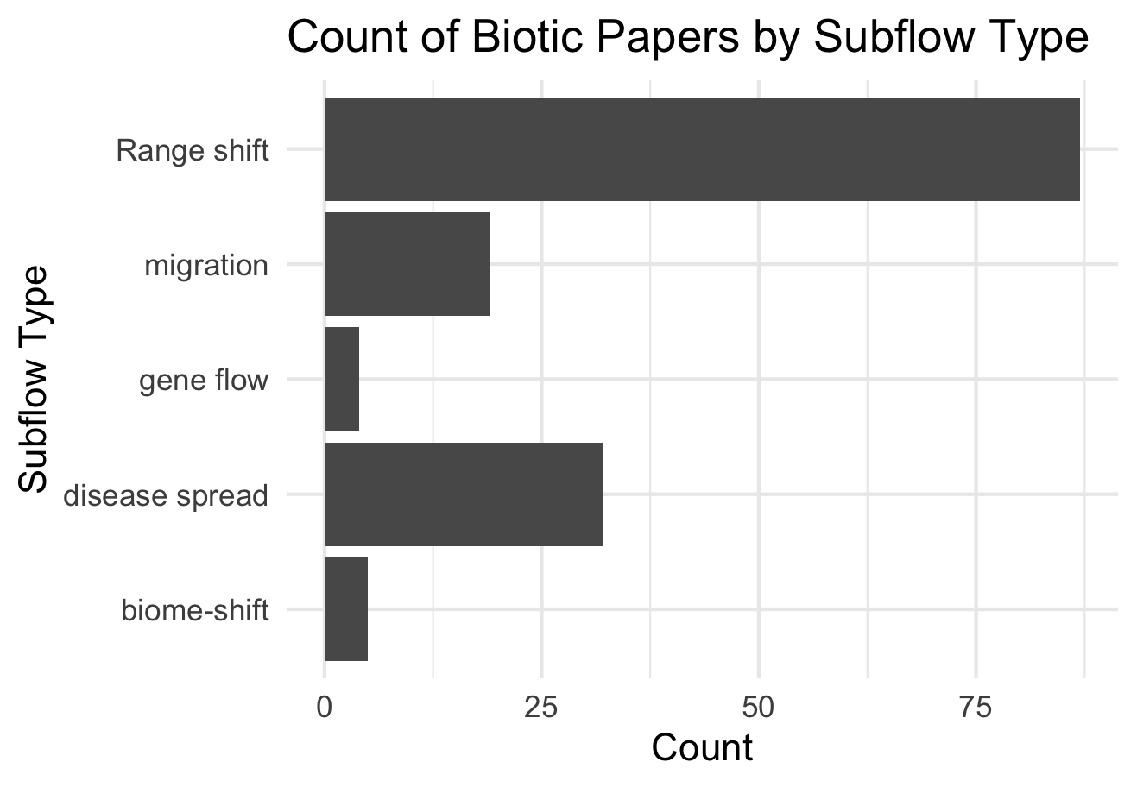

Slide 10
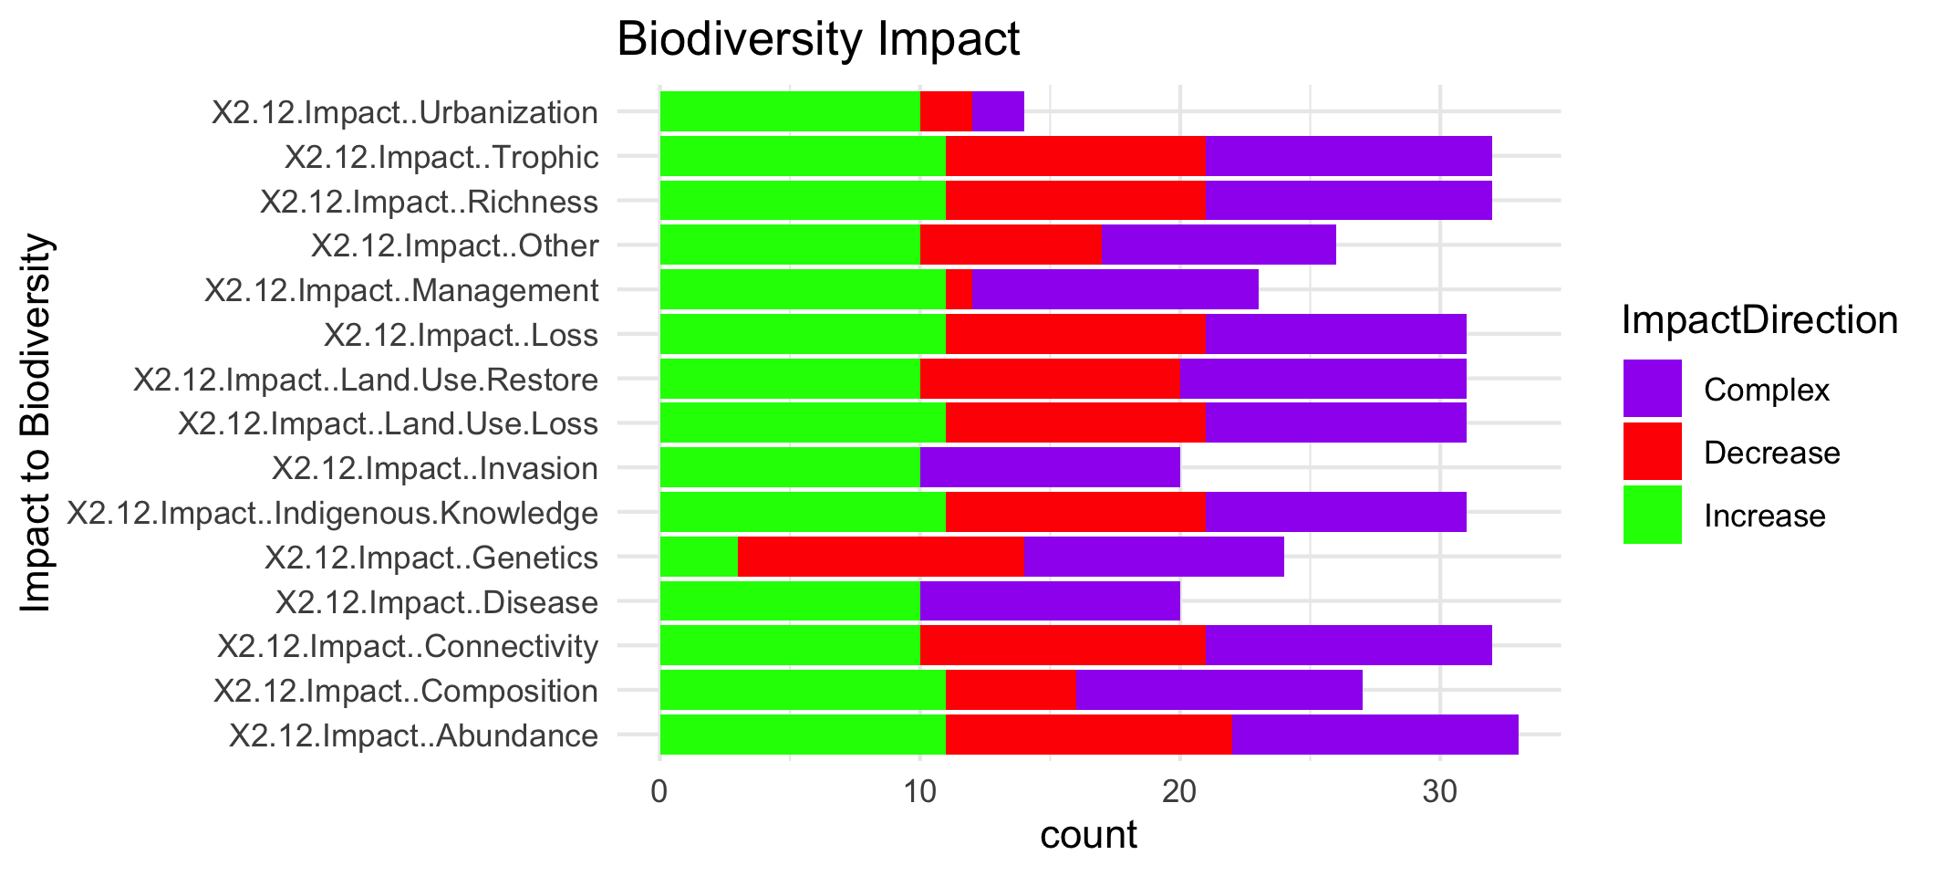

Slide 12
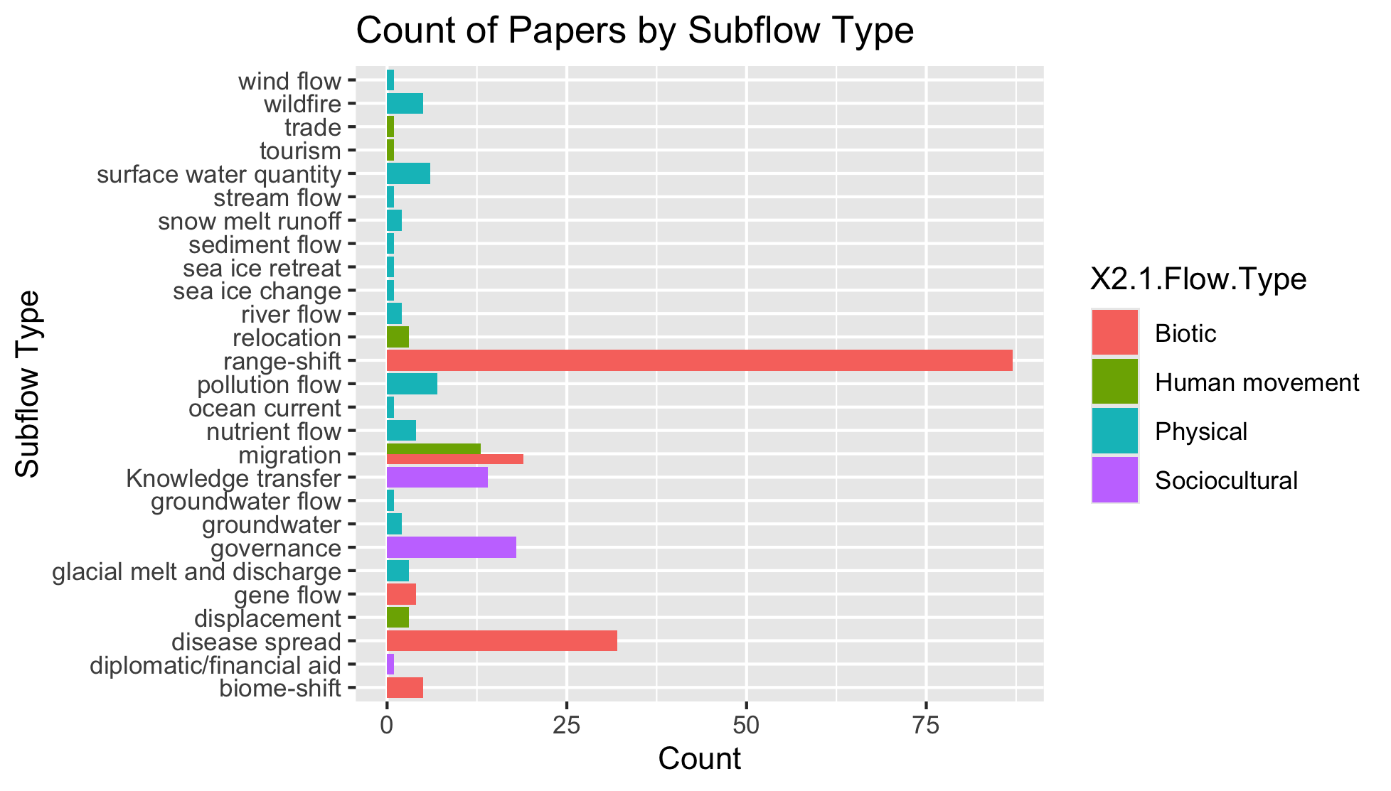
To group physical flow papers

Slide 13
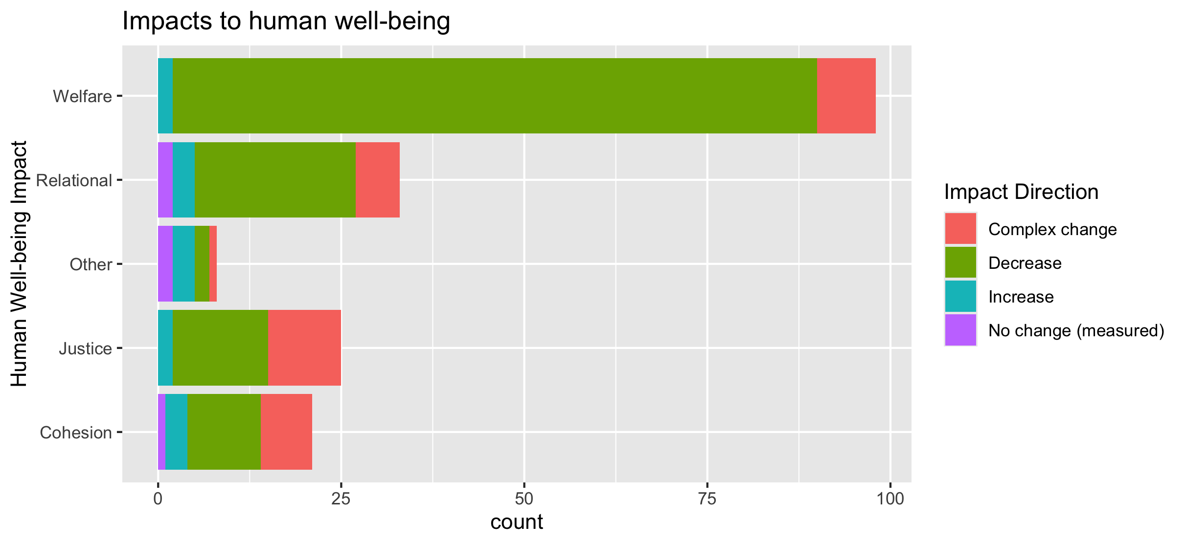
To align direction colors with final color pallet

Slide 14
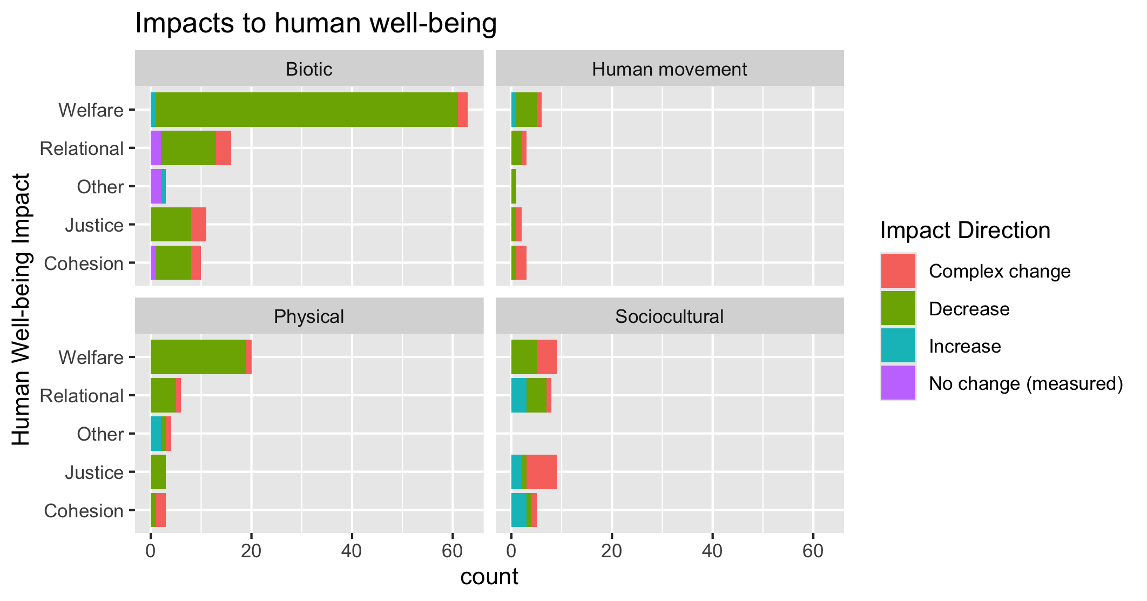
To align direction colors with final color pallet

Slide 15
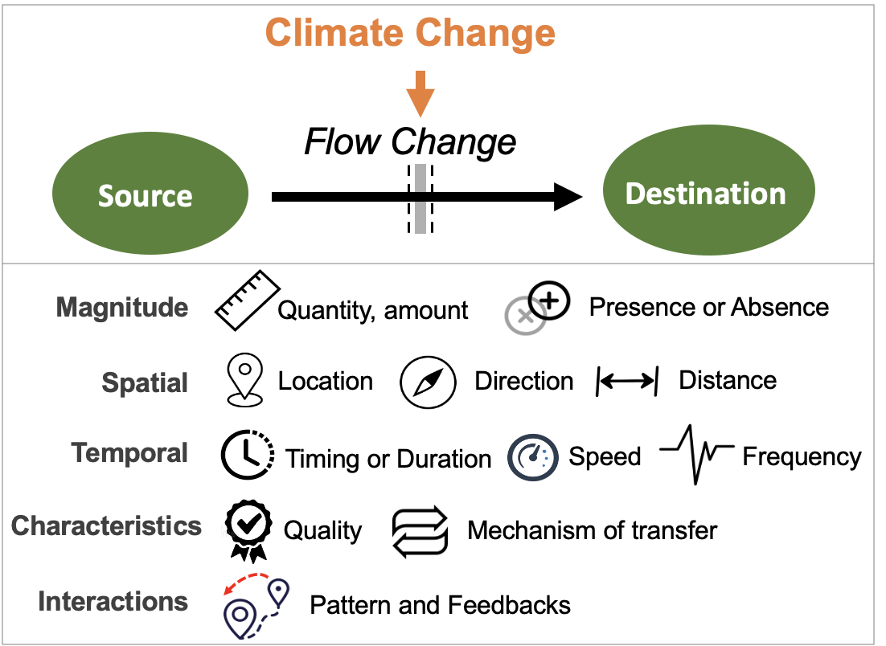
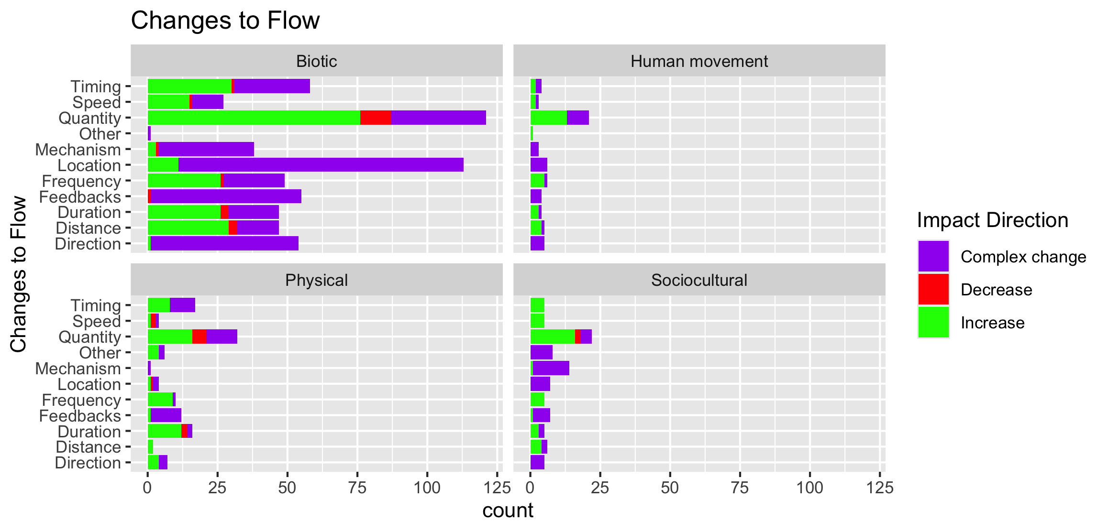

Slide 16
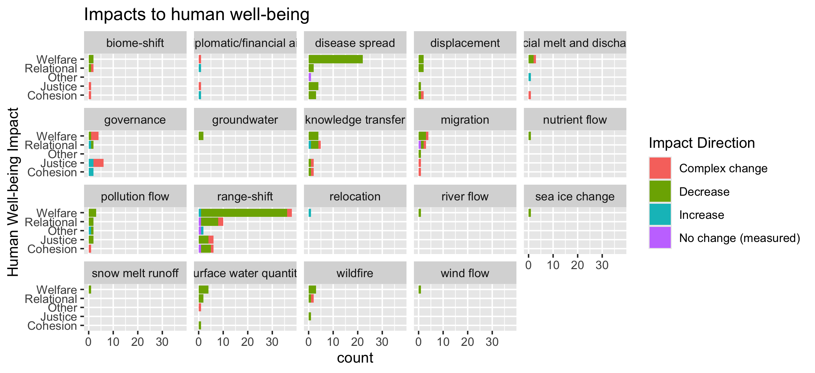
To group physical flow papers

Slide 17
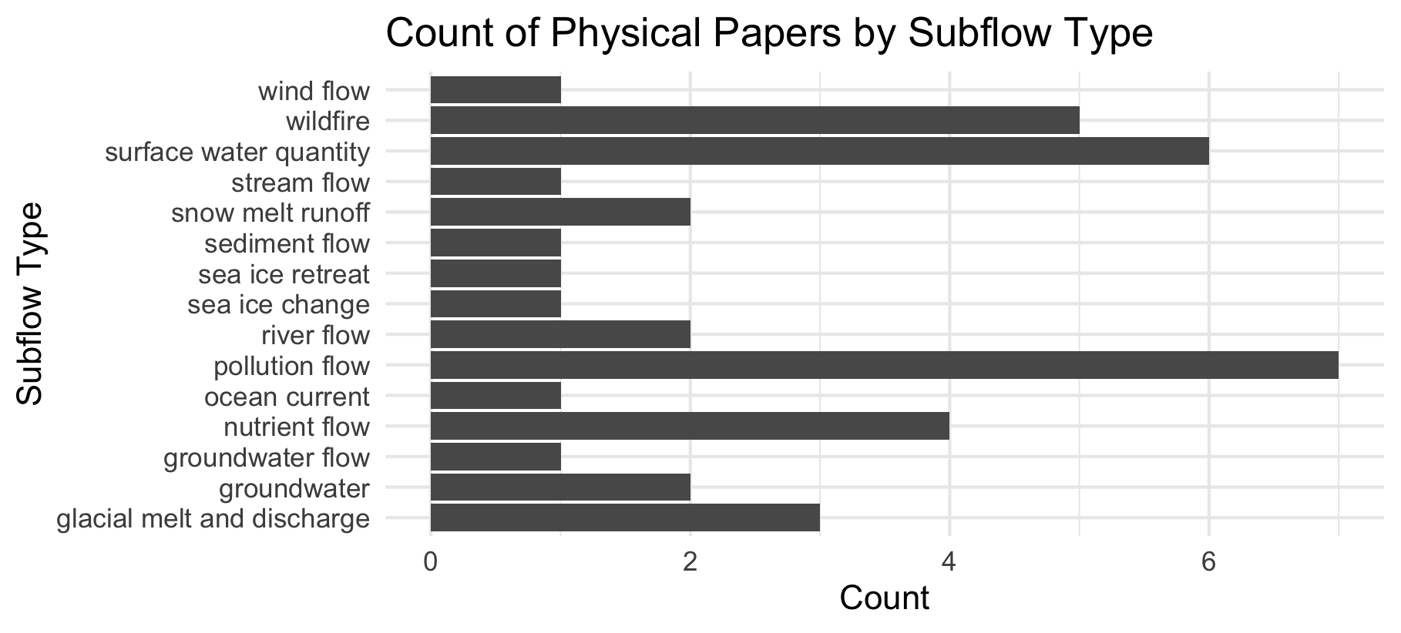

Slide 18
Feb 23 2025

Slide 19
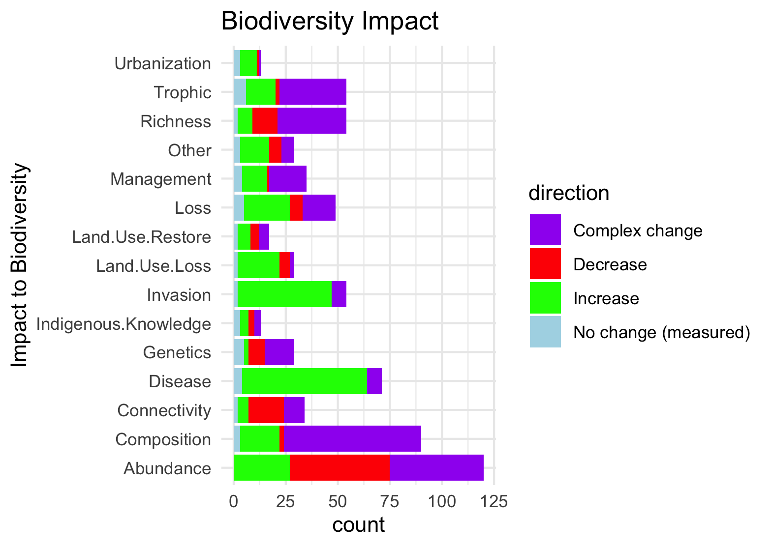
Needs to be grouped by what is good and what is bad to see increase in:

Slide 20
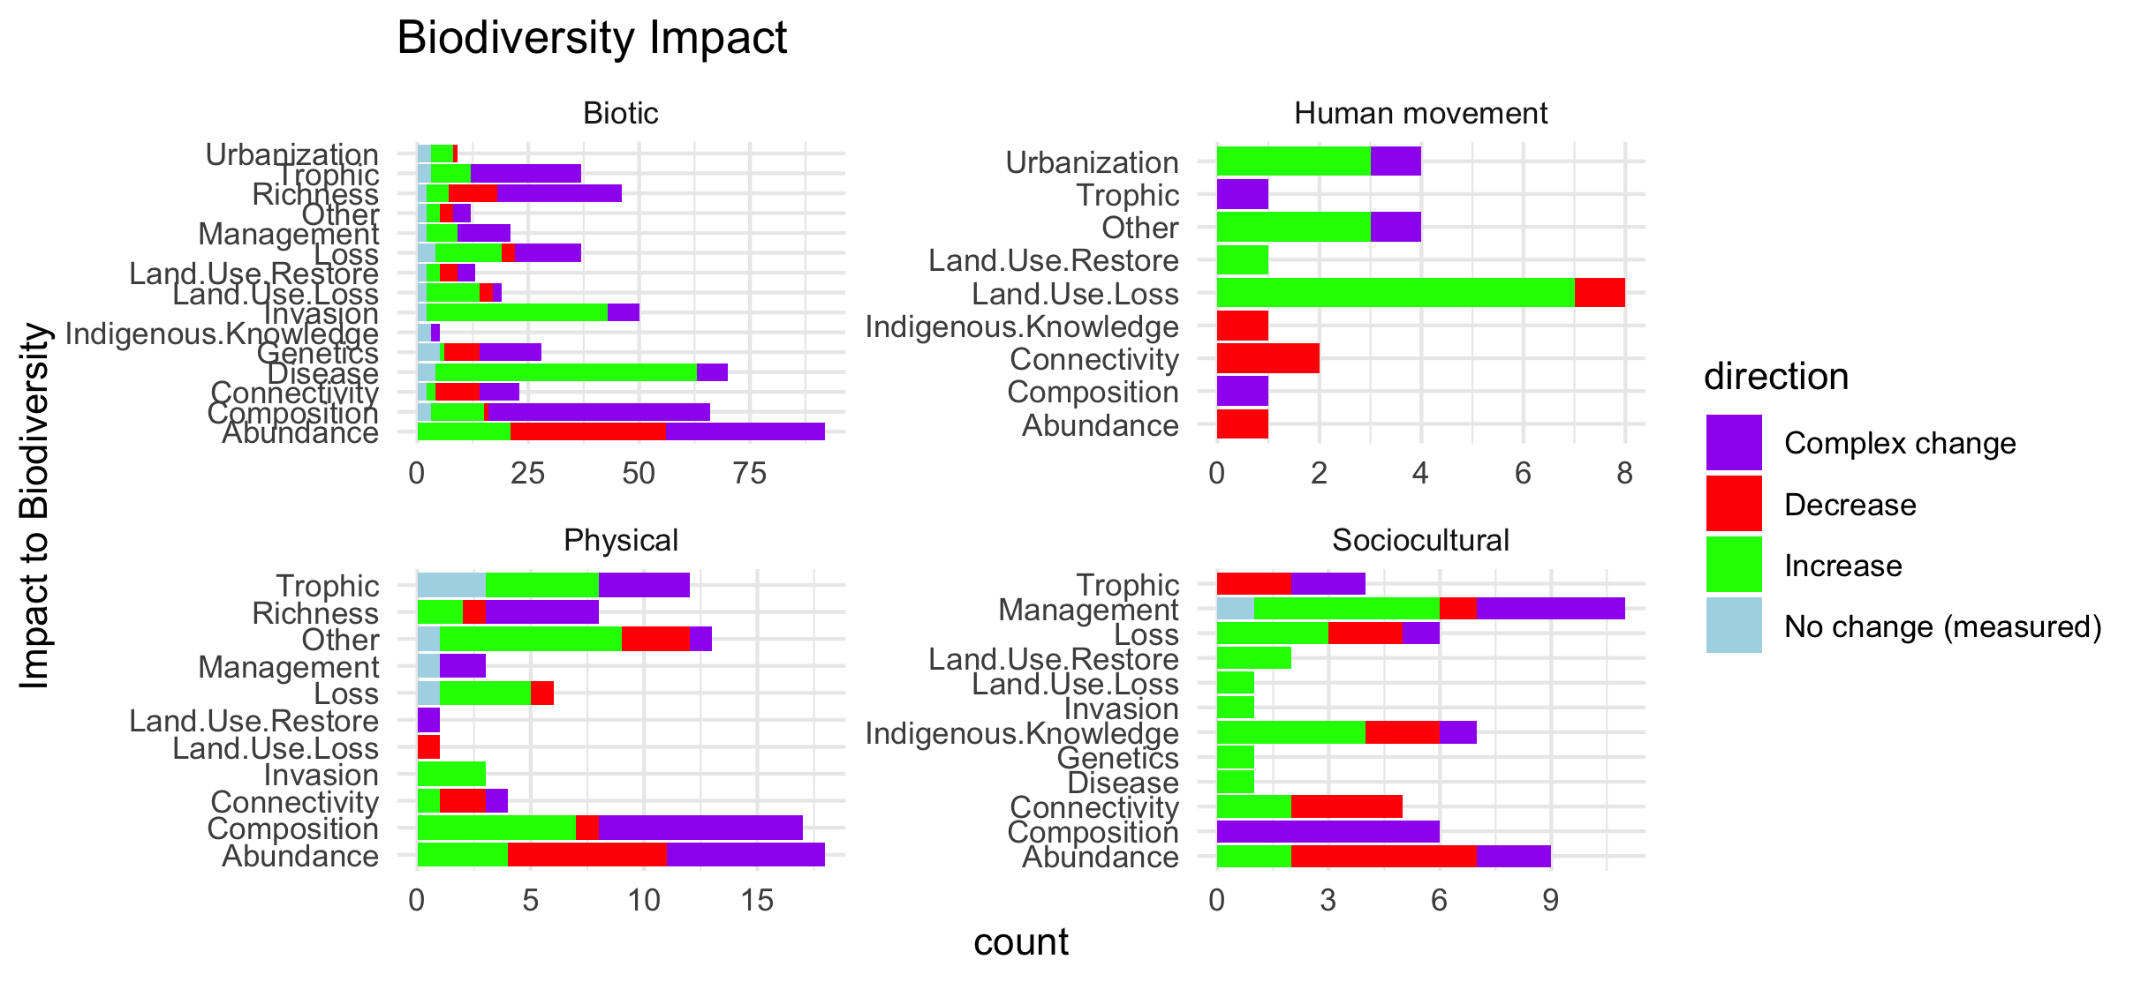
Scale free on the facet (diff x axis)

Slide 21
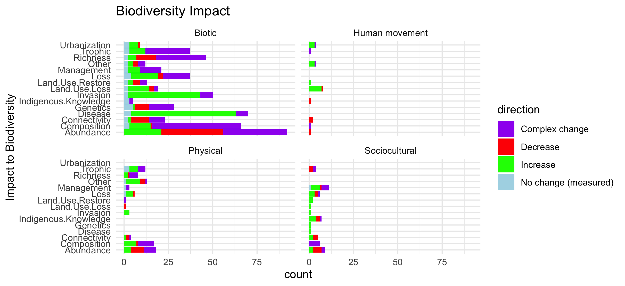
Scale fixed on the facet (same x axis)

Slide 22
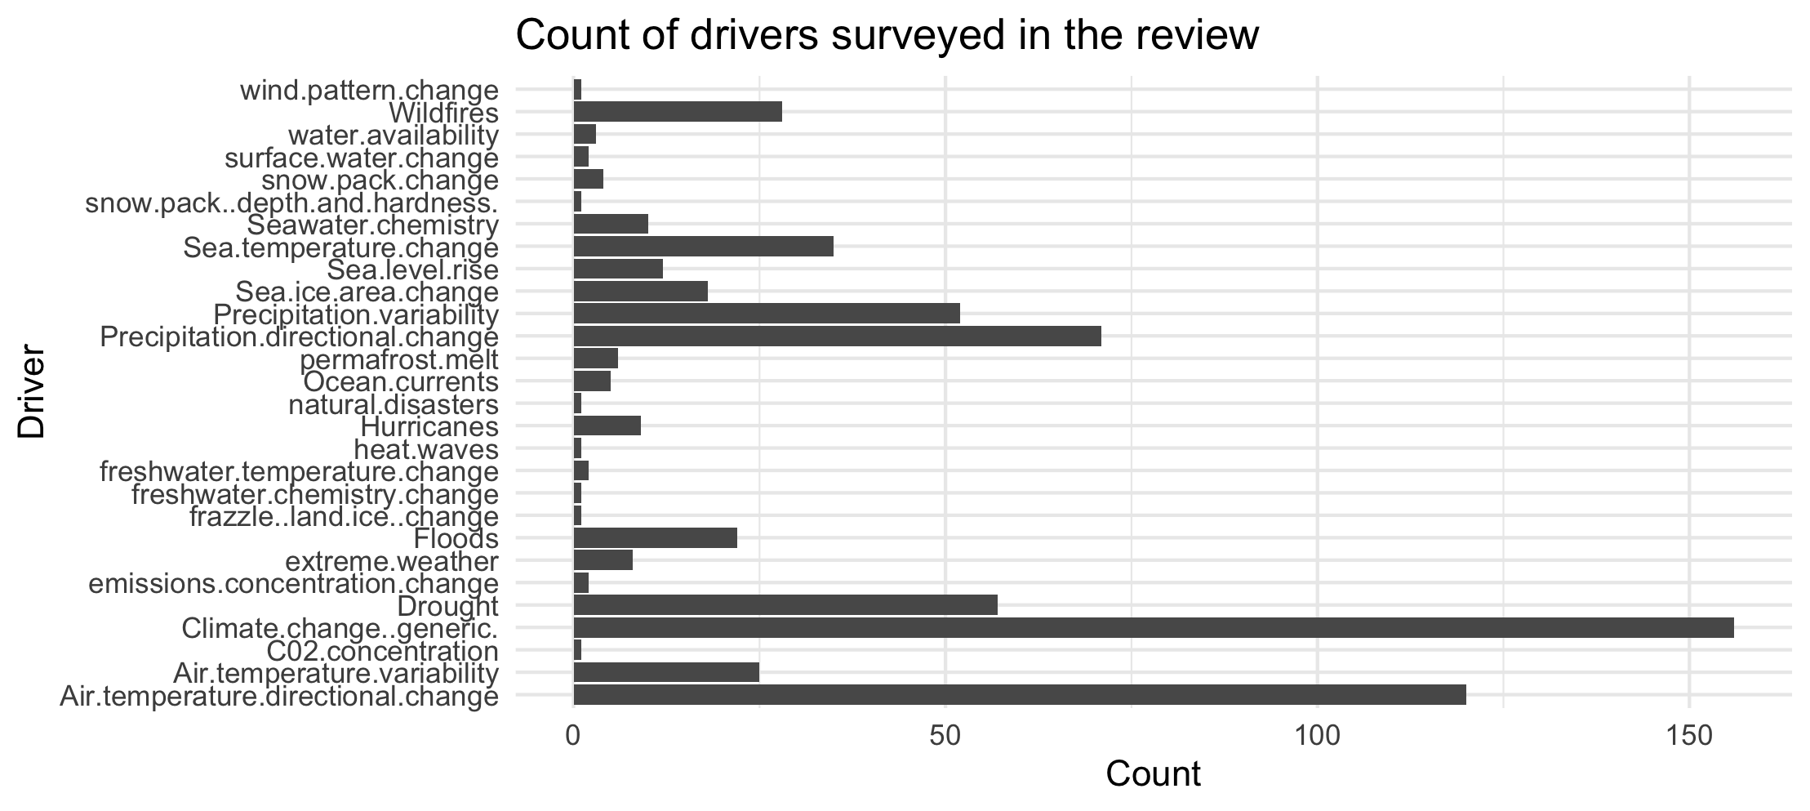

Slide 23
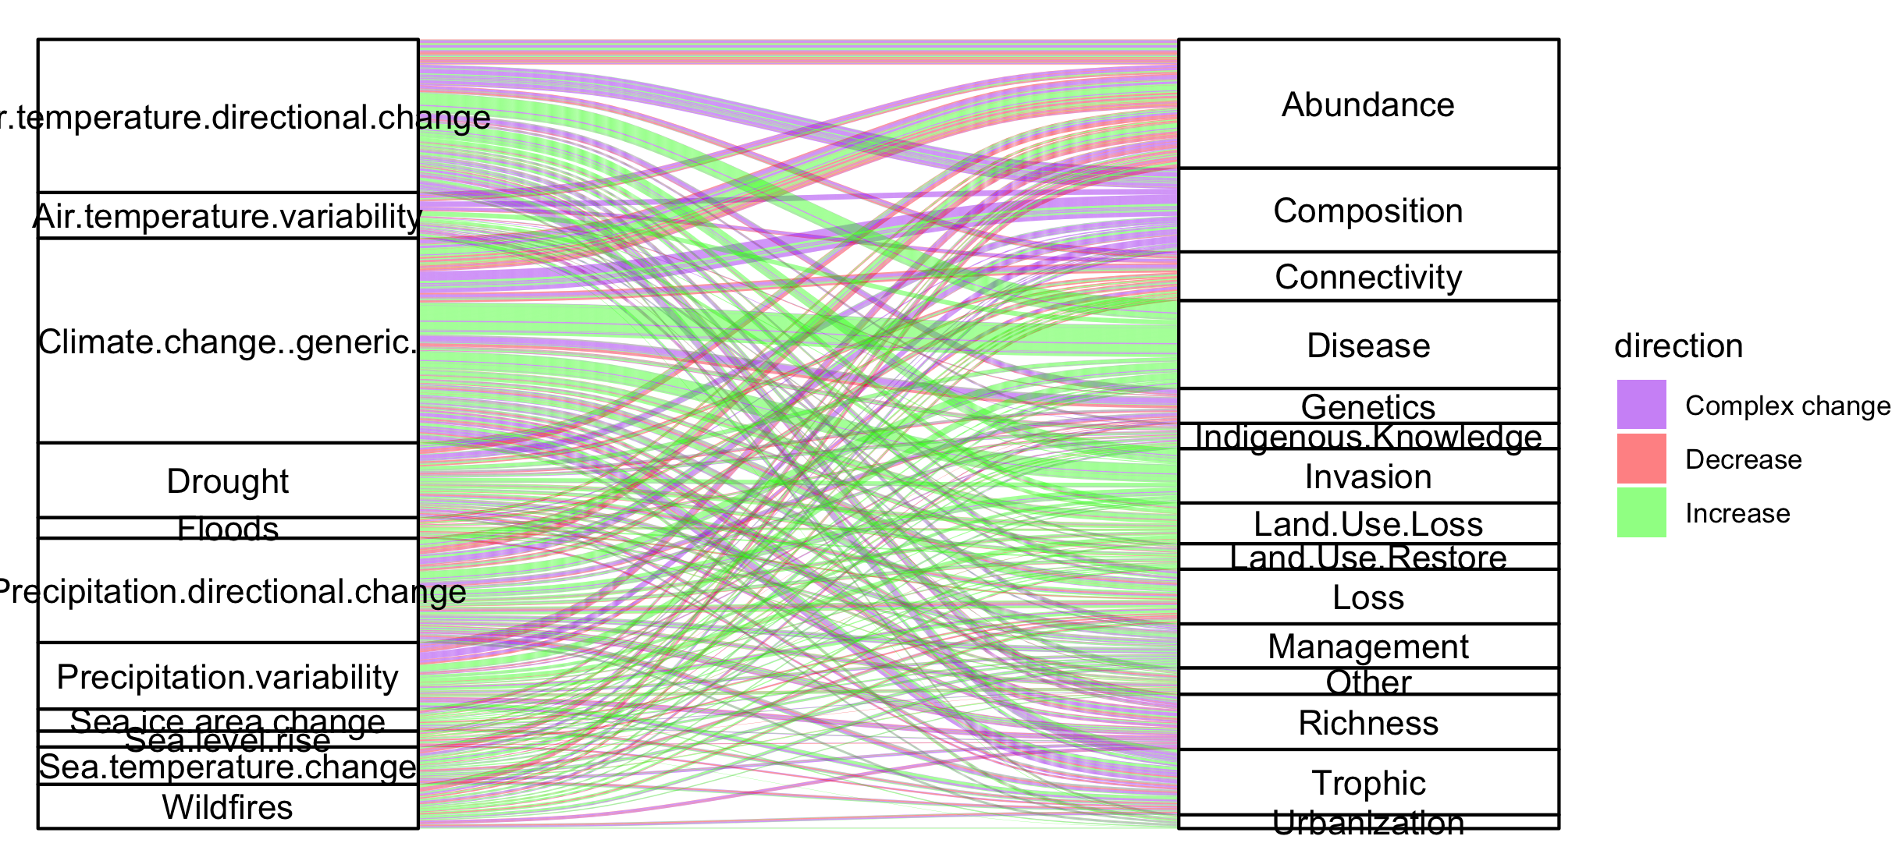
Colleen: see note isn the code – we could group spme of the drivers (hurricaines, extreme weather, ands ome of the ice ones). This still doesnt take into account if changes arw good or bad though and might just be too busy.

Slide 24
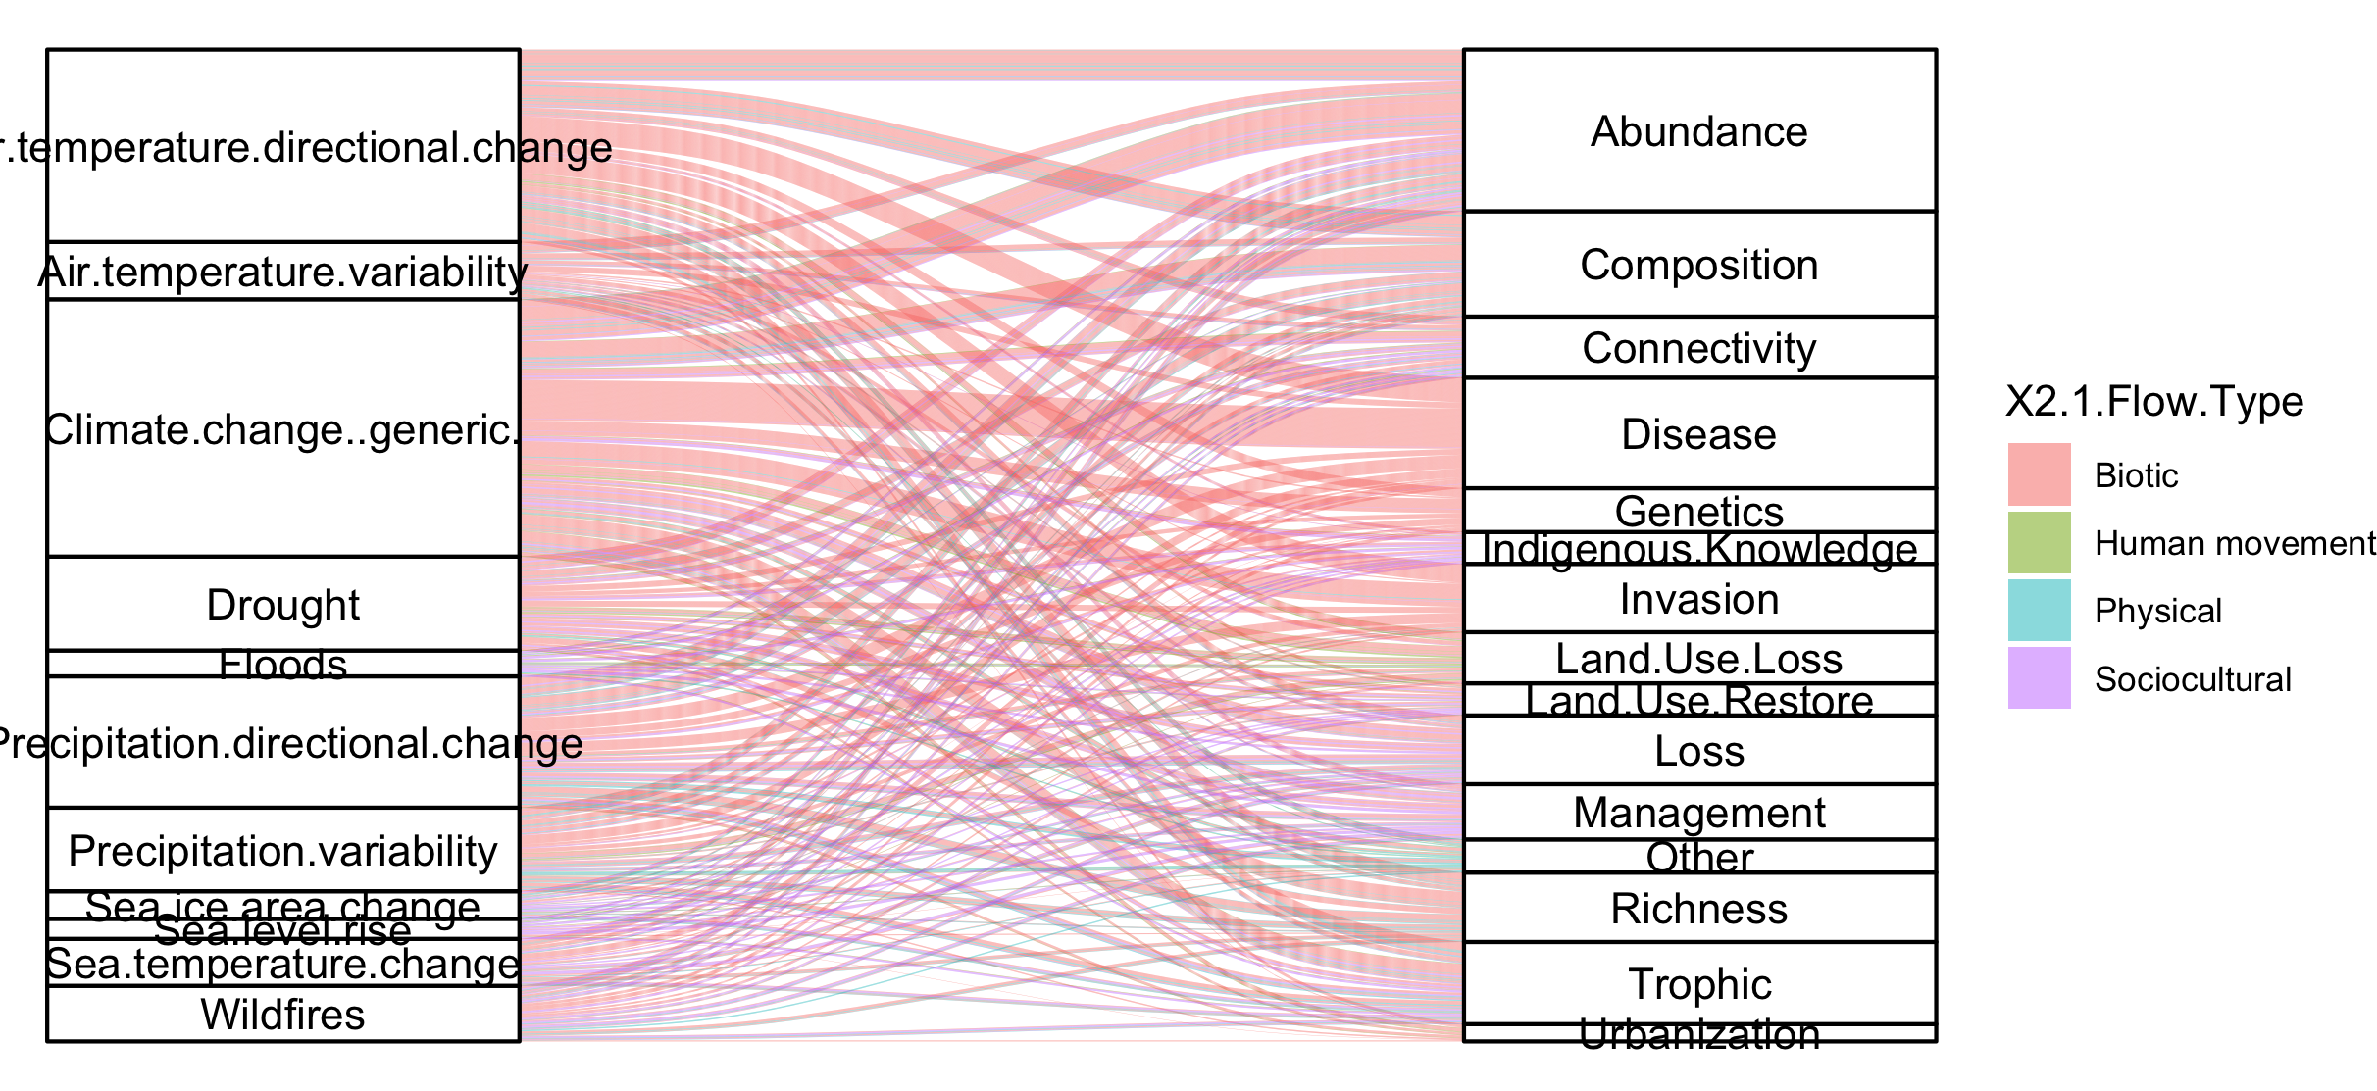
#not that informative because so many more of the papers are biotic

Slide 25
NCPs

Slide 26
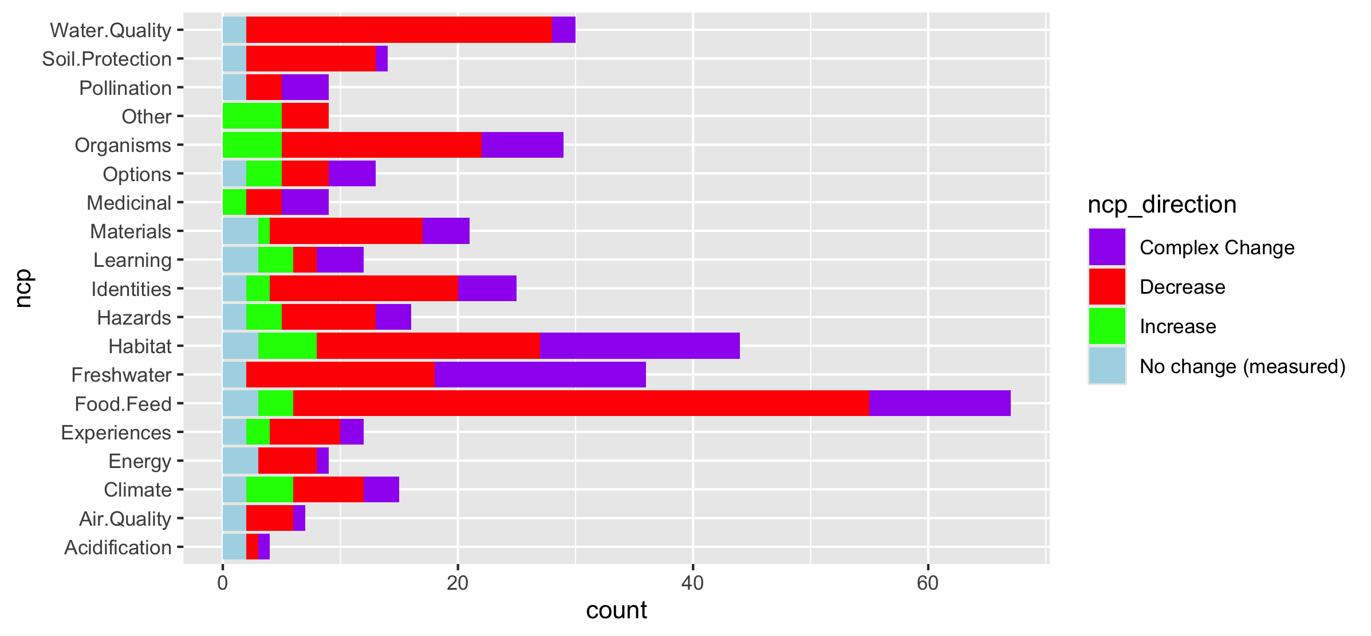
Fix labels

Slide 27
Do by flow type

Slide 28
Fix labels

Slide 29
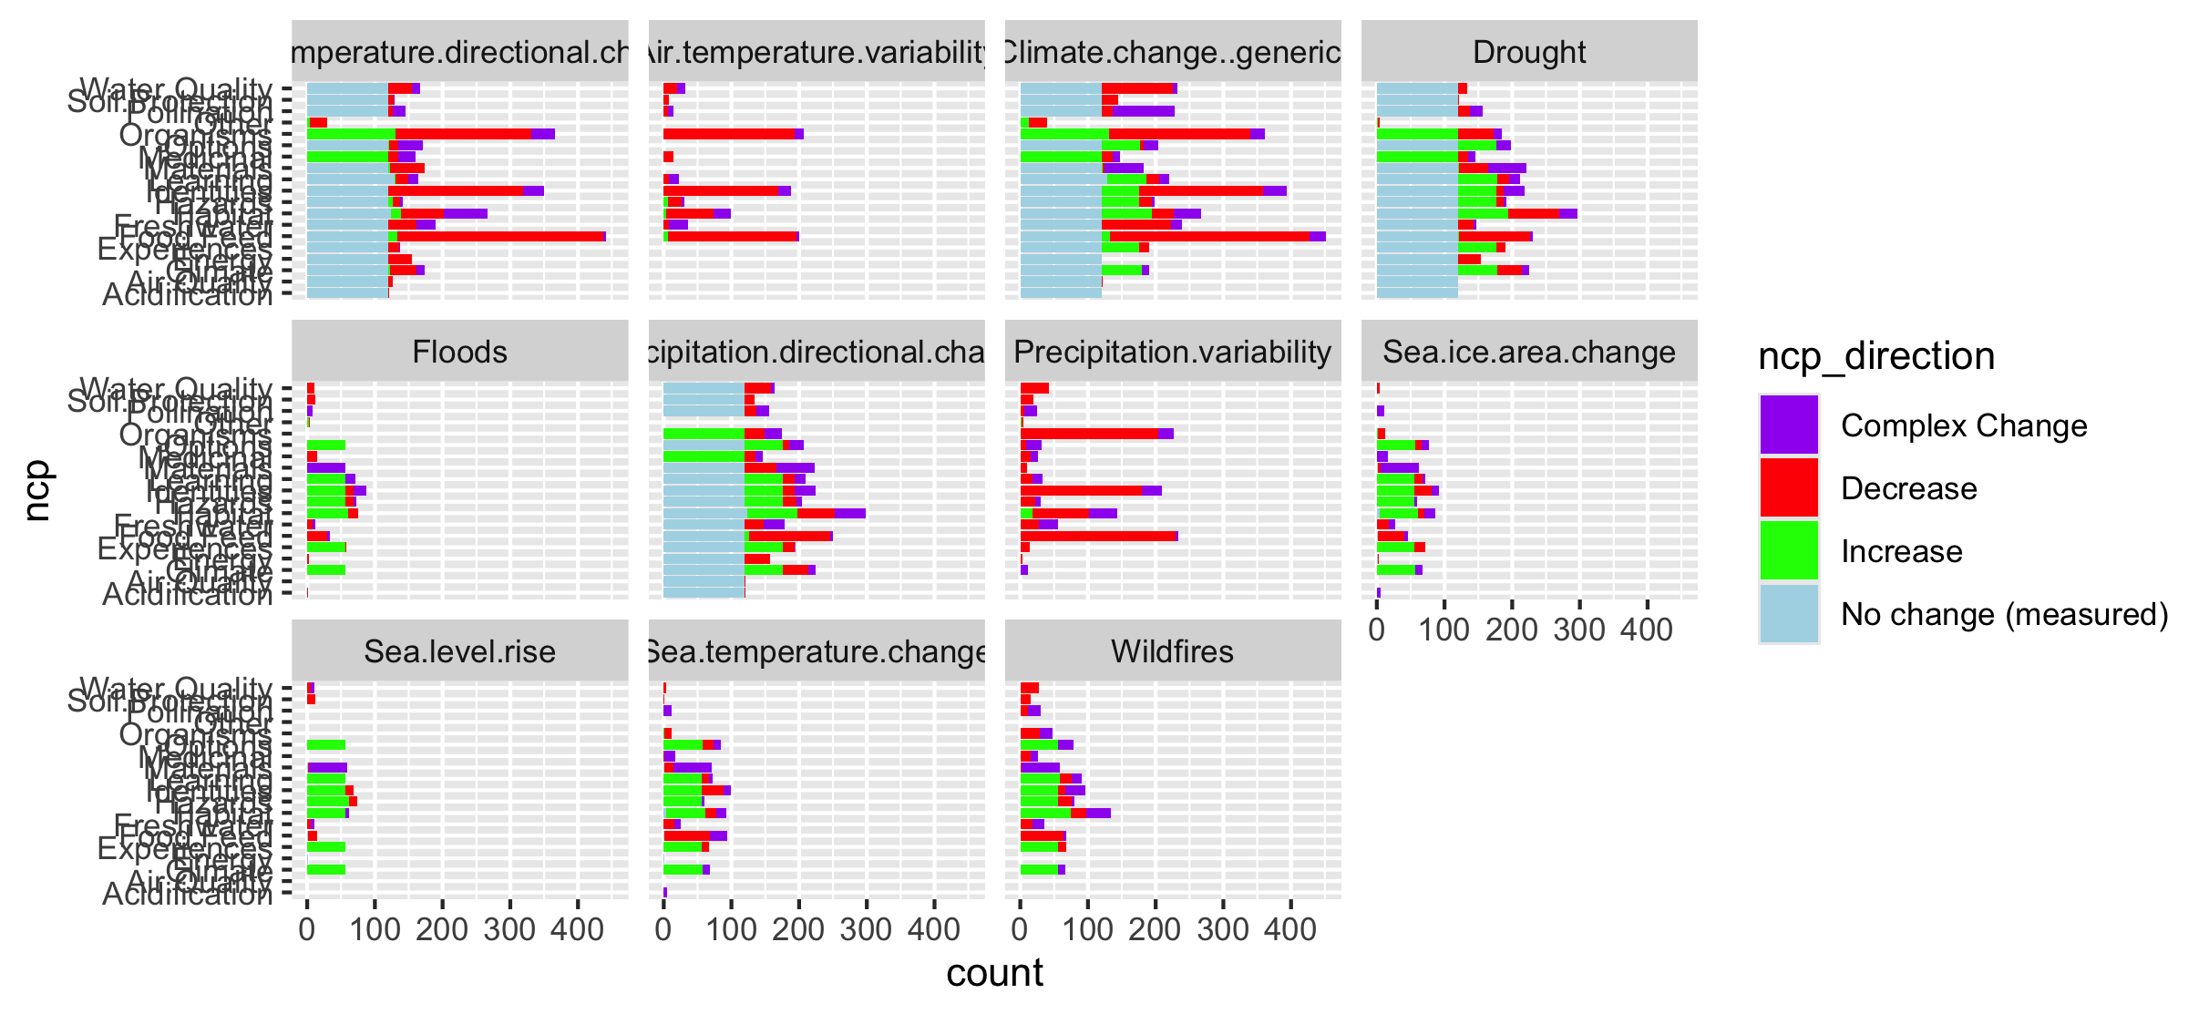

Slide 30
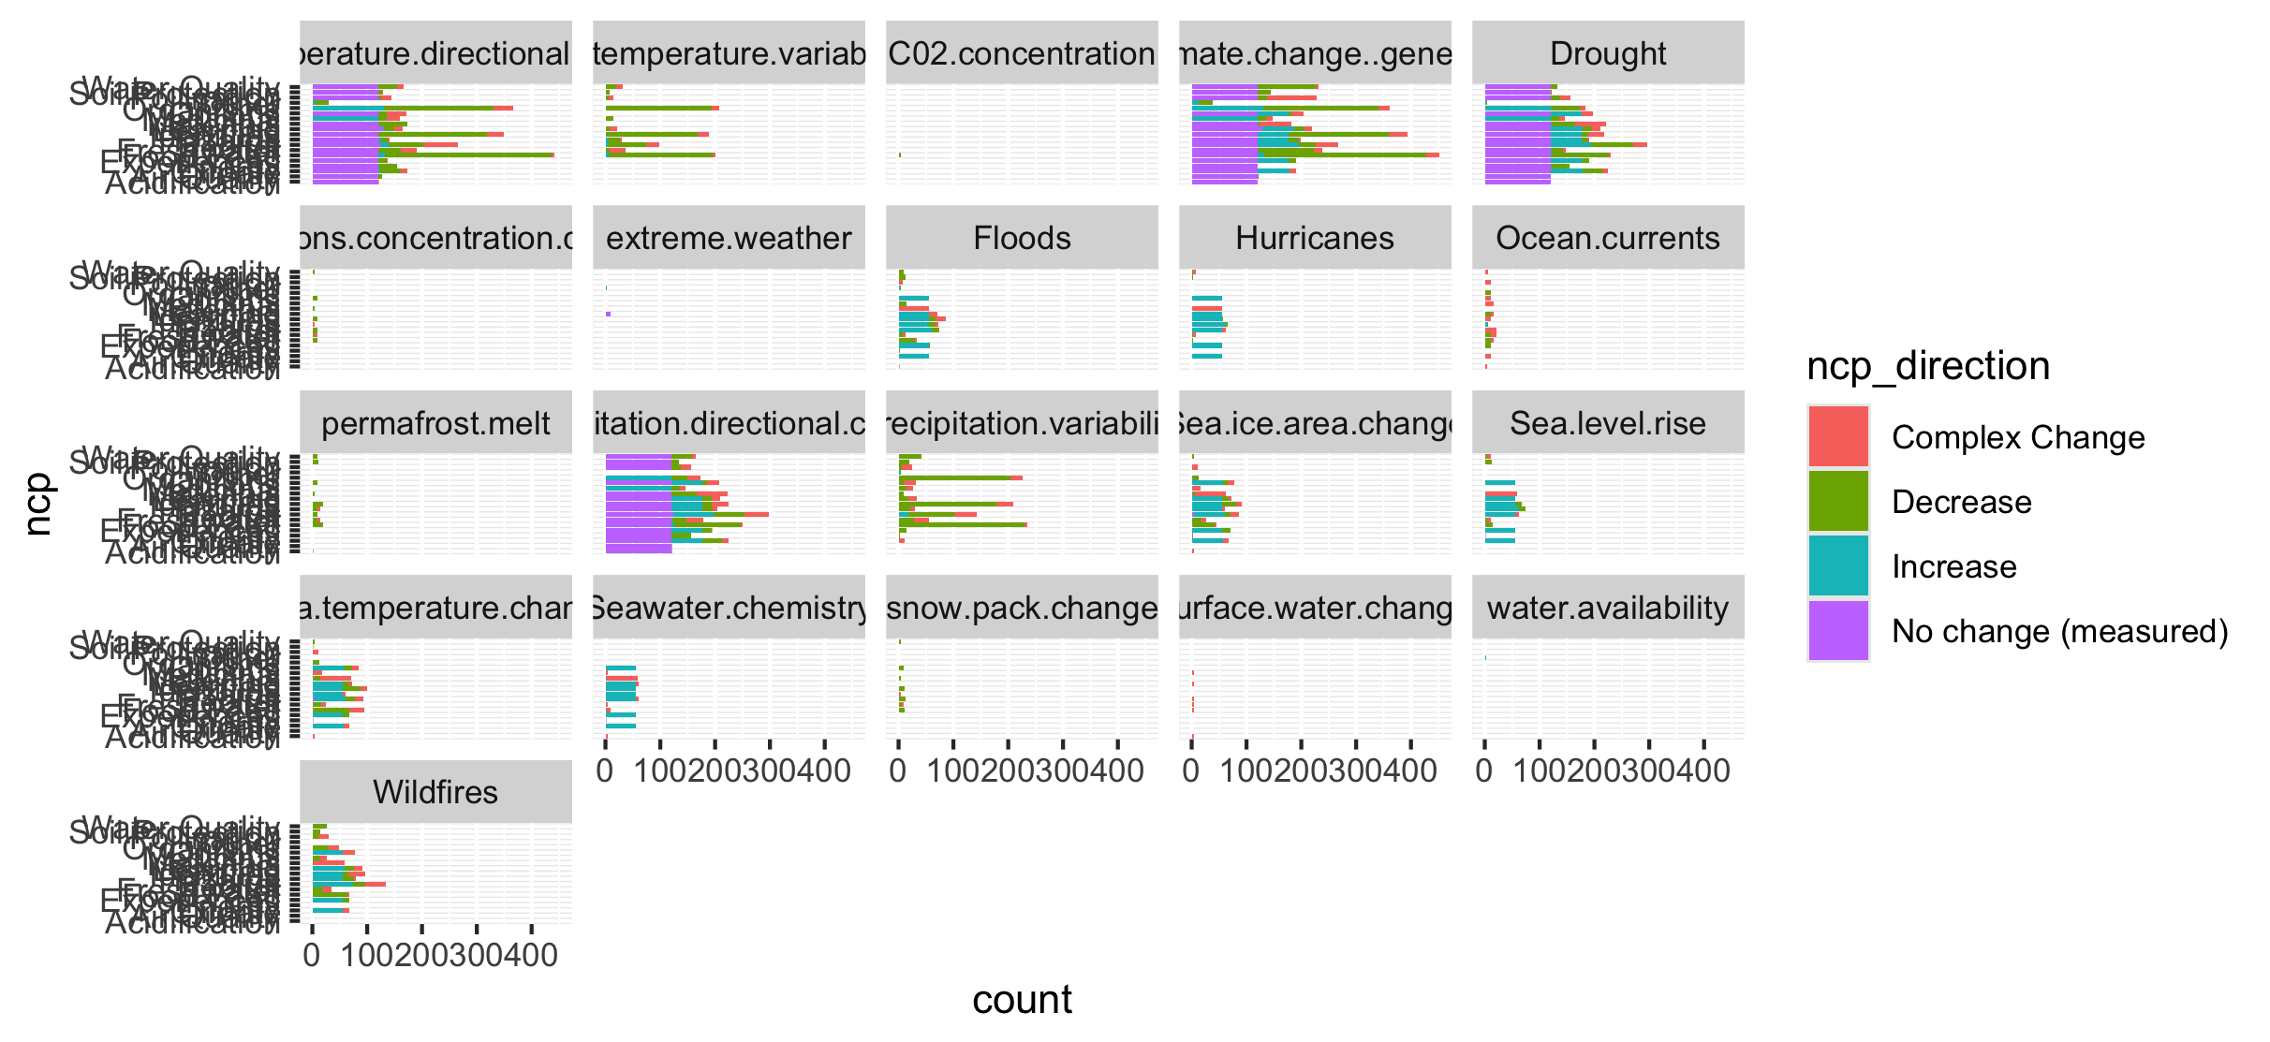
Too many drivers

Slide 31
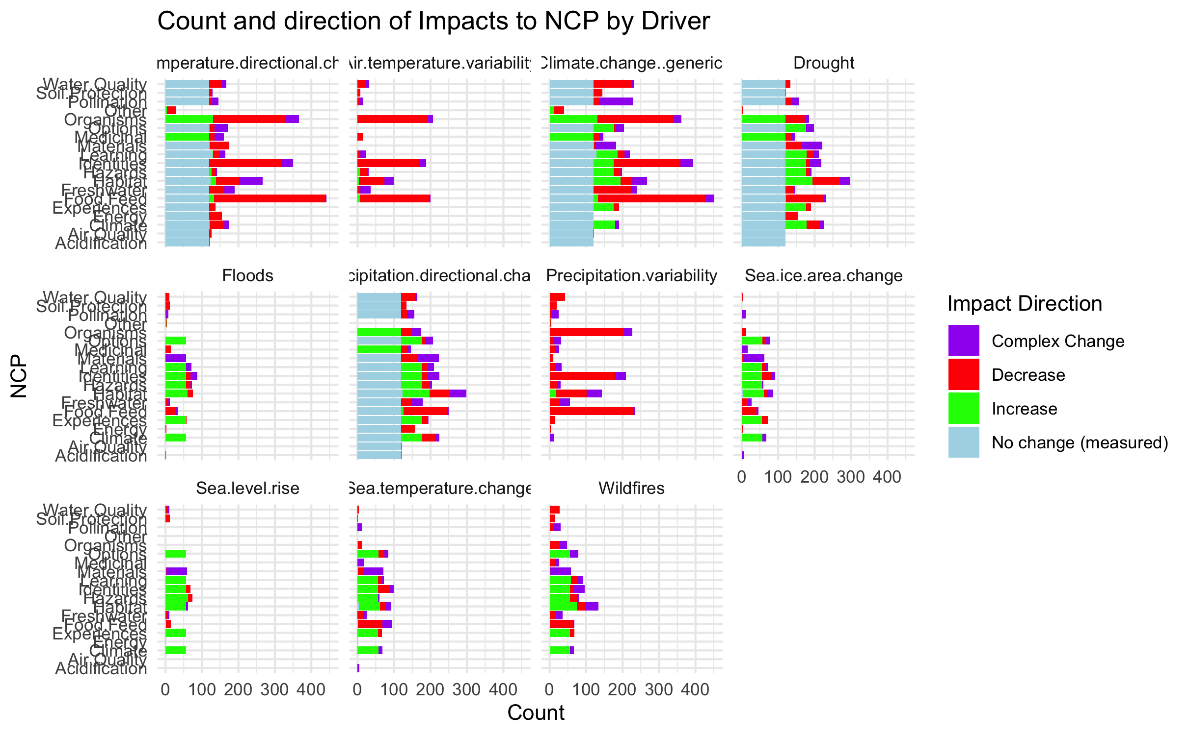

Slide 32
HWB

Slide 33
Connections – how does altered flow relate
Driver~ altered flow (by flow, and subflow – grouped out by flow
Altered flow~ impact (for each category)

